Slide 1
Lecture 9 - Hashing Passwords
Chad Mourning
Heavily influenced by the Textbook

Slide 2
Procedure
Store the hashed version of the password. Hash again as necessary, check if new hash == stored hash
Salting
Introduced in 1979
Usually randomly generated and stored in plaintext with the hashed password
Prevents rainbow table attacks
This is a case where a hash function shouldn’t be particularly fast so people can’t brute force as easy
But if you are a running a commercial operation, maybe you do it quick anyway so you don’t spend cycles on wasteful hashing
Also prevents people with the same password from having the same Hash
Decreasing Social Engineering targets
Makes it harder to detect password reuse

Slide 3
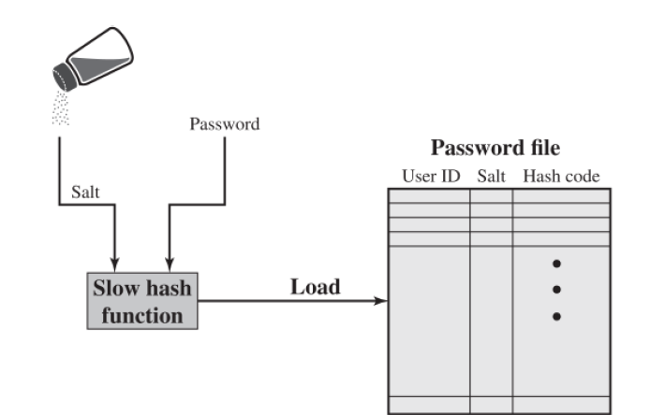
Creating a new Password

Slide 4
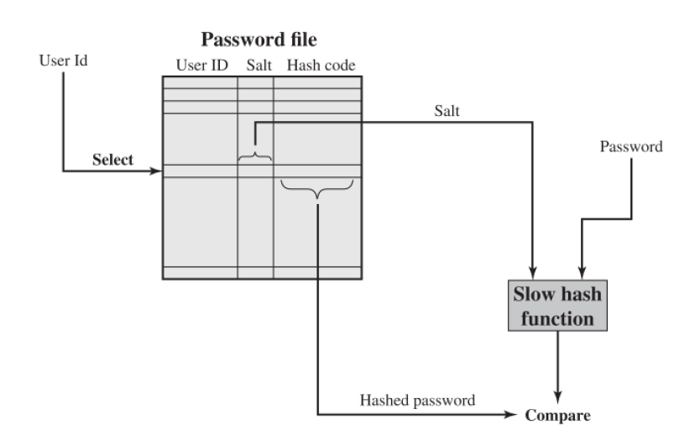
Verifying a Password

Slide 5
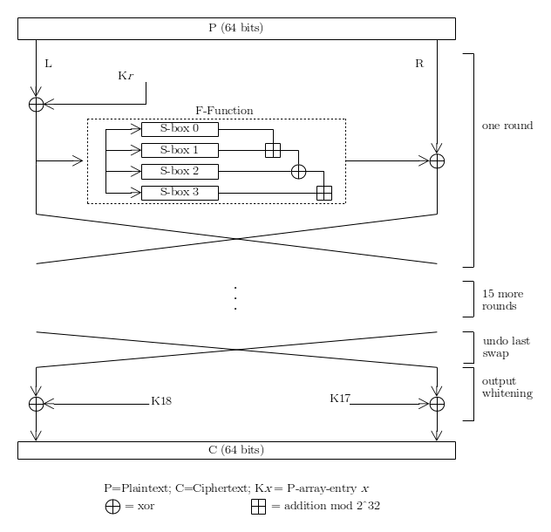
Contemporary Salting
Bcrypt/Blowfish
Developed in 1993 by Bruce Schneier
Up to 55 character passwords
128 bit salt
Includes a cost variable that lets you slow down the hash
More details here:
https://en.wikipedia.org/wiki/Blowfish_(cipher)
Is this where the Hugh Jackman movie got it’s name? I never saw it.
Vulnerable to Birthday Attacks
Read more here: https://sweet32.info/ - 2^{n/2}
Inventor actually recommends people use the sequel, Twofish, instead
https://en.wikipedia.org/wiki/Twofish
Was an AES finalist
Yes, there is a Threefish: https://en.wikipedia.org/wiki/Threefish
Doesn’t use S-Boxes like DES, Blowfish, and Twofish because they are susceptible to cache timing attacks

Slide 6
Aside: Timings attacks on Square and Multiply
If the bit of the exponent is a 1, square your number, if it’s odd, square and multiply by the original number.
Math holds under modulos!
Live Demo!
Supplemental Viewing: https://www.youtube.com/watch?v=cbGB__V8MNk
What’s the vulnerability?
1s and 0s behave differently, so based on the time it takes you can guess how many ones there are.
Countermeasure: Constant-time approaches

Slide 7
Password Cracking, Classical
Rainbow Tables
Space vs. Time
2003 paper - 1.4GB cracked 99.9% of all alphanumeric Windows password hashes in 13.8 seconds.
Size of table will correlate with hash and salt length.
Brute Force against multiple targets
Even if you lock an account at 5 attempts, that means for 1,000 accounts you get 5,000 attempts.

Slide 8
Password Cracking, Modern
GPU-based cracking
Brute force hashing is a perfect SIMD operation
RockYou.com
In 2009, the website was hacked via SQL-injection and 32M plaintext passwords were leaked.
https://www.kaggle.com/datasets/wjburns/common-password-list-rockyoutxt
Lots of research done on this list for trends.
Probabilistic models, -- try the most common ones first.
Maybe that’s an easy project for this week if I don’t think of anything else.
Good starting dictionary for attacks.

